Slide 1

Boston Subway Station Analysis
IBM Data science certificate capstone
Jordan Lieberman
June 2020

Slide 2
Overview
1. Goals
2. Data Sources
3. Regional Map
4. Results
5. Conclusion

Slide 3
Goals
Identify rapid transit stations throughout the Boston metro region
Map the stations using folium as a visual aid to the user
Use FourSquare to explore different types of venues near each MBTA station
Categorize venues into broad groups to better organize and understand the results
Pivot and clean the data into a more readable format
Rank the stations based on counts of different venue types

Slide 4
Data Sources
MBTA Developer Page
https://www.mbta.com/developers
FourSquare Places API
https://foursquare.com/developers/apps
Python Libraries for Mapping
Geocoder and Folium

Slide 5
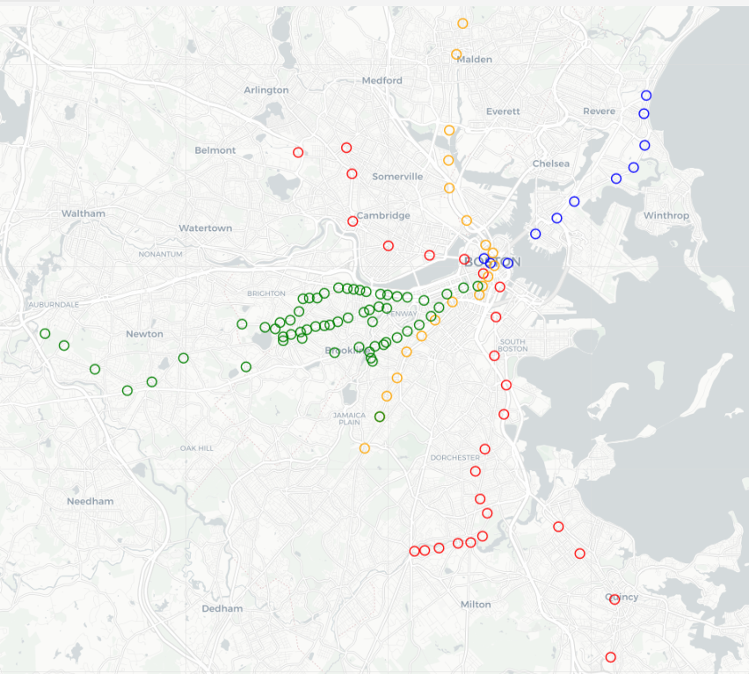
Regional Map of Stations
Color coding indicates the subway line: red, blue, orange, and green

Slide 6
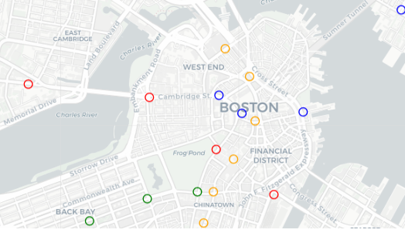
Regional Map (Zoom)
Partial map of the downtown area of Boston

Slide 7
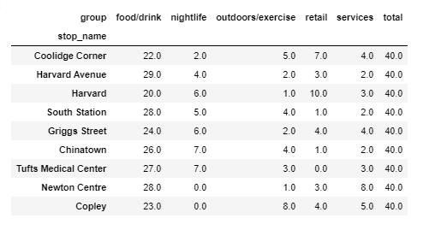
Results – Top 9 Stations

Slide 8
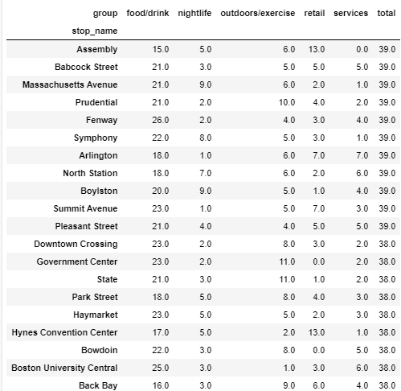
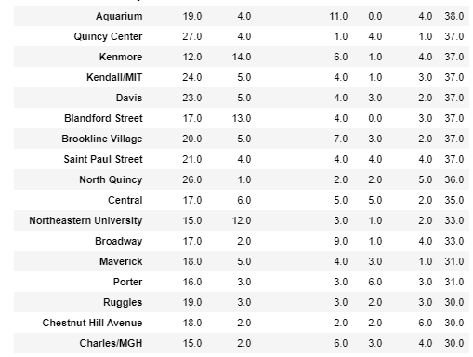
Results – 30 to 39 Venues

Slide 9
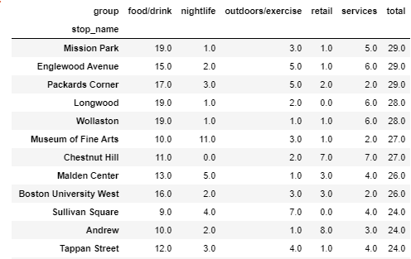
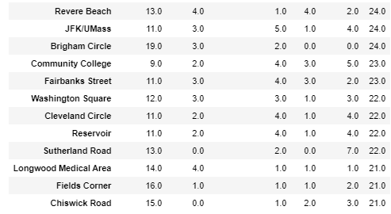
Results – 20 to 29 Venues

Slide 10
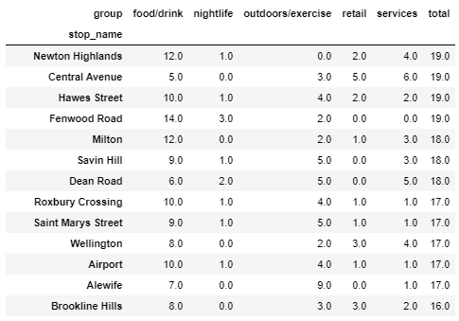
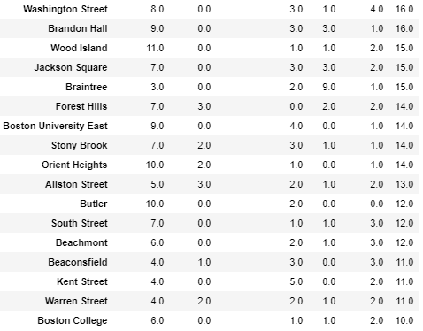
Results – 10 to 19 Venues

Slide 11
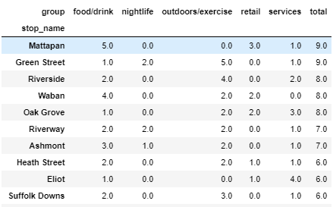
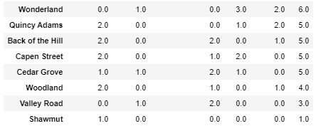
Results – Under 10 Venues

Slide 12
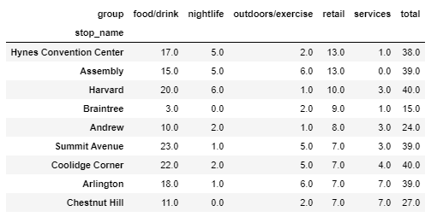
Results – Most Retail

Slide 13
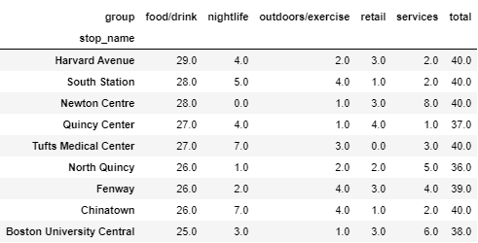
Results – Most Food/Drink

Slide 14
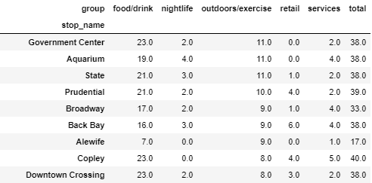
Results – Most Outdoor/Exercise

Slide 15
Conclusion
Many MBTA stations throughout the Boston region have a wide variety of interesting venues in close proximity
Several stations far from the city center are surprisingly dense for their locations far from the city center
Users may identify desirable stations to live or work near that still provide rapid access to the rest of the region

